Slide 1
REAL TIME SIGNLANGUAGE
INTRODUCTION
The goal of this project was to build a neural network able to classify which letter of the Indian Sign Language(ISL) alphabet is being signed, given anaction of a signing hand. This project is a first step towards building a possible sign language translator, which can take communications in sign language and translate them into written and oral language. Such a translator would greatly lower the barrier for many deaf and mute individuals to be able to better communicate with others in day to day interactions.

Slide 2
Description of overall software structure
As shown in figure our project is divided into four major parts: Data Collection , Data Processing, Training and Predicting Gesture.
1. Data Collection : First of all we have collected data for a total of ‘eighty’ different actions(labels) in our project, each of thirty videos has thirty sequences of frames, through the webcam. Extracted the key points of each frame and stored it in their specified directories.
2. Data Processing : In this step we have labeled all the actions in sequence after that brought the data together and structured it. Then converted into categorical data using the to_categorical() method from tensorflow.keras.utils. Finally, split the complete dataset into a train and test dataset using train_test_split() method from sklearn.model_selection. Five percent of the data is for testing, the rest are left for training the model.

Slide 3
3. Training : To train our model we have used the Long Short Term
Model(LSTM) Neural Network. To create that first we have imported the required dependencies which include tensorflow keras sequential Model, LSTM layer and Dense Layer.
The Neural Network consists of a sequential model above it is three LSTM relu activation layer, two Dense relu activation layer lastly one Dense softmax activation layer. Then we have compiled the model at ‘Adam’ optimizer and ‘categorical_crossentropy’ loss function. After compiling, we passed the model to fit() on the training dataset with 2000 epochs.
4. Predicting Gesture : when our model is trained on the training dataset, we have saved the model and used it to .

Slide 4
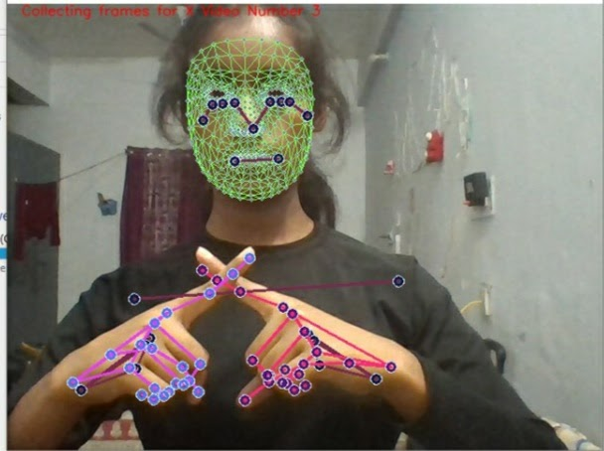
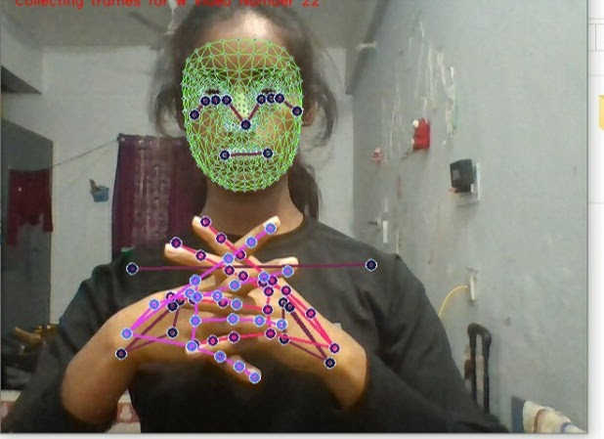
2. Source of data
Fig1 : collecting Data for x Fig2: collecting Data for w

Slide 5
Data collection
The primary source of data collection is webcam only. We have collected thirty videos for each label or action each with thirty sequences of frames. Above the webcam video we have created a landmark using media-pipe holistic and extracted the key features for every action. Those key features have been saved in the respective direction.

Slide 6
Data Pre-Processing First we have traversed through each label and labeled them into integers using enumerate() method. Then we have started to load our data and for that purpose we have created the sequences array which will contain all the features or x-variables and labels array which represents labels y-values, which will be used to represent the relationship between features and labels while training our model. Then we have traversed through every action and every sequence. Afterwards we have created a window array variable and loaded it with frames every sequence using np.load() method. So basically the above steps is loading test data for training in a structured way to perform operations.

Slide 7
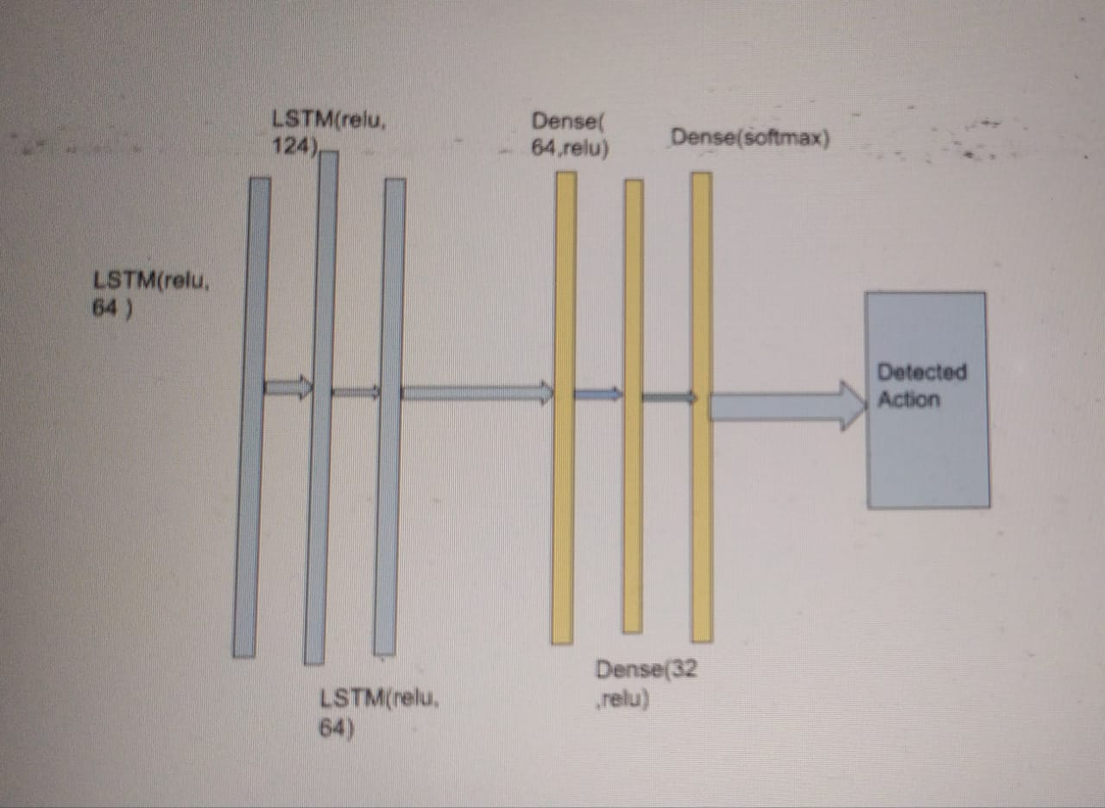
Machine Learning Model
Overall Structure

Slide 8
The model used in this prediction task is fairly the basic use of Long Short Term Model (LSTM) Neural Network. Our project consists of using a Media pipe detection model to detect hand, face and shoulder and draw the landmark over it,extract the key points and save it in sequence and use it to train the model for further detection.
First we have initialized our model with a sequential() model for the processing of a simple stack of images. Above that we have applied three layers of Long Short Term Model (LSTM)Neural Network.
In the first layer of LSTM with 64 units, return_sequence to ‘True’(setting to true means that its output will be used to pass through another LSTM layer for training), activation ‘relu’ and also has defined the shape to (30,1662).

Slide 9
The second layer of LSTM is with 128 units return_sequence to ‘True’(set to True because we have to pass the output of this layer to another LSTM layer), with return_sequence set to ‘True’ and activation set to ‘relu’. And the third layer of LSTM is with 64 units , return_sequence set to ‘False’ (because we do not have to pass this through the same) and activation set to ‘relu’.
Also we have added another three Dense layer in which the first Dense layer is of 64 units with activation set to ‘relu’ and second Dense layer is of 32 units with activation set to ‘relu’. And the last Dense layer is set to
activation ‘softmax’.

Slide 10
Model Performance
We have trained our model using the Adam optimizer and Cross Entropy Loss. Adam optimizer is efficient among the adaptive optimizers. Adam optimizer is known for converging
quickly in comparison with Stochastic Gradient Descent (SGD), even while using momentum.

Slide 11
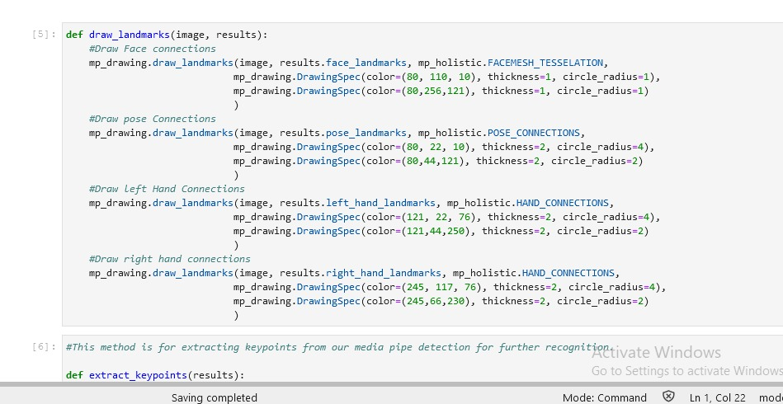
In this section we have created method to draw the landmarks to get the visual knowledge of what is being detected, joints are shown with big dot or circle and they are joined with a line. In this section we have created method to draw the landmarks to get the visual knowledge of what is being detected, joints are shown with big dot or circle and they are joined with a line.In this section we have created method to draw the landmarks to get the visual knowledge of what is being detected, joints are shown with big dot or circle and they are joined with a line.

Slide 12
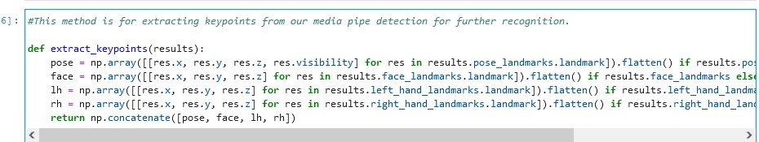
This section of code defines the method is defined to extract the key points of face, each hands and shoulder and returns the combined numpy array. This section of code defines the method is defined to extract the key points of face, each hands and shoulder and returns the combined numpy array. This section of code defines the method is defined to extract the key points of face, each hands and shoulder and returns the combined numpy array. This section of code defines the method is defined to extract the key points of face, each hands and shoulder and returns the combined numpy array. This section of code defines the method is defined to extract the key points of face, each hands and shoulder and returns the combined numpy array.vThis section of code defines the method is defined to extract the key points of face, each hands and shoulder and returns the combined numpy array.

Slide 13
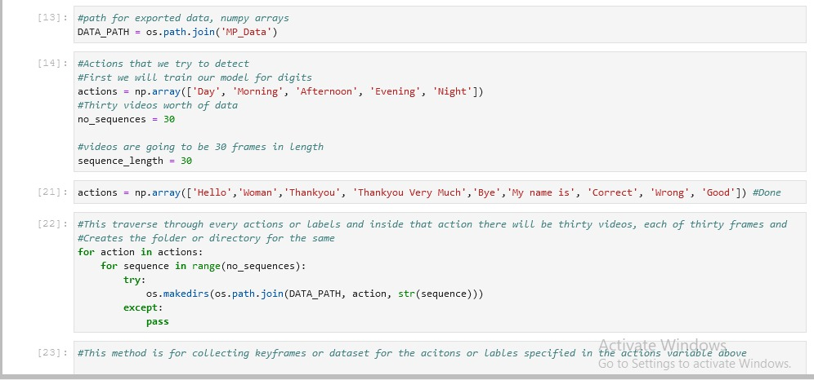
Then we have created directory named 'MP_Data' which contains the dataset for each actions or labels each with thirty videos.Then we have created directory named 'MP_Data' which contains the dataset for each actions or labels each with thirty videos.

Slide 14
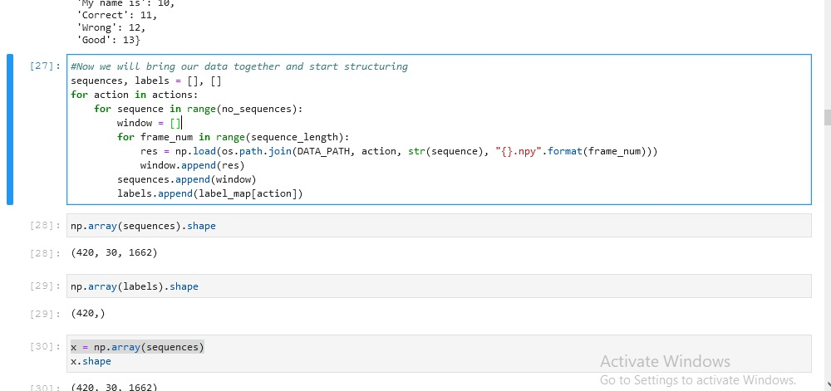
After Collecting and labelling the data we have started structuring and bring it to the variable to be worked upon, the same is shown in the above image.

Slide 15
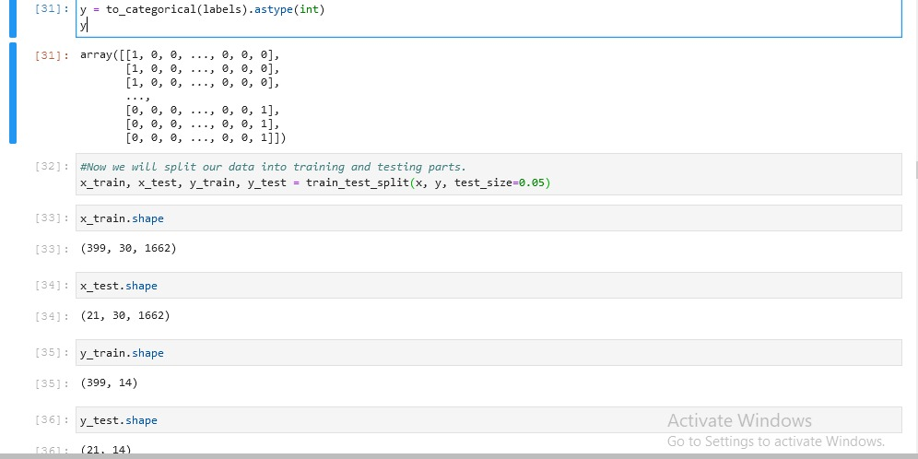
After converting into categorical data we splitted our dataset into training and testing datasets. Training set of data will be used to train/make the model learn and the test set will be used to check how our data is responding when some action is passed through it.

Slide 16
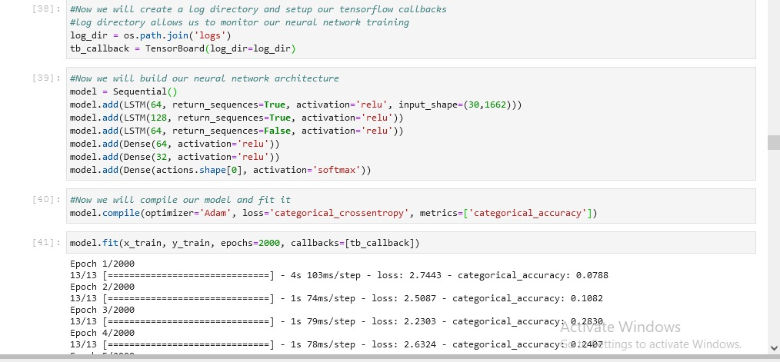
This section of code defines the our Long Short Term Model Neural Network. And compiled our model on 'Adam' Optimizer, 'categorical_crossentropy' loss function. Then we have fitted our with 2000 epochs calls, but if model gives the accuracy before that then we can stop the training force fully. For instance, we have stopped our model at 54 epochs.

Slide 17
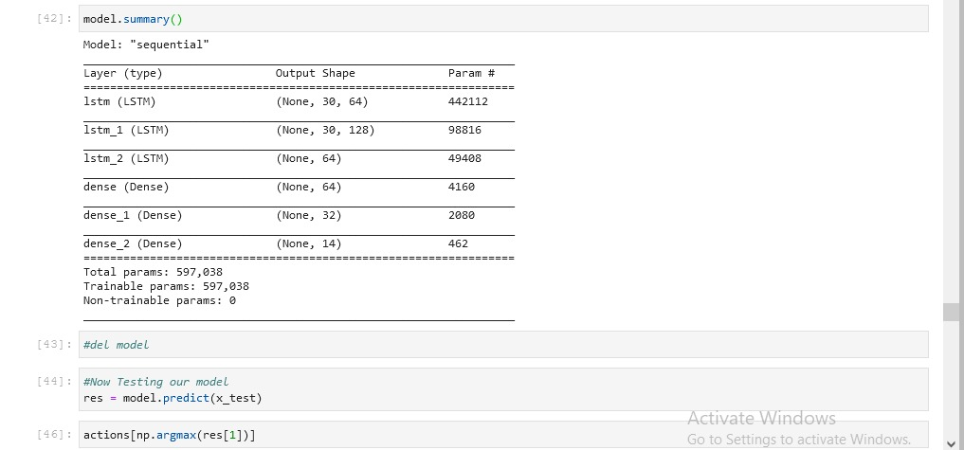
This screen shot shows the overall summary of the model.

Slide 18
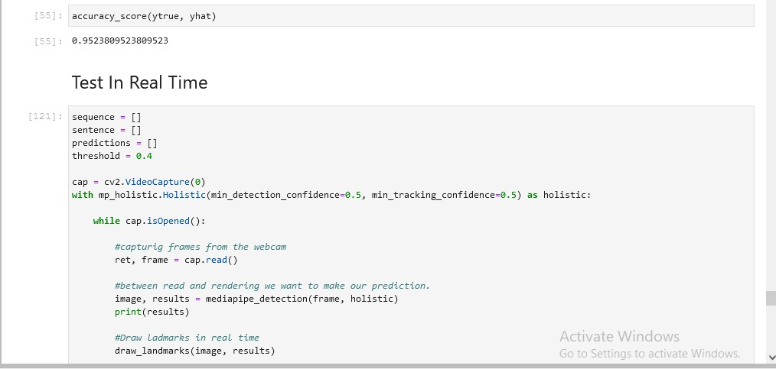
Further in our program we have calculated multilabel confusion matrix and then calculated accuracy score which in this case is 0.9523. Then we have done the testing in real time.

Slide 19
Model Performance
We have trained our model using the Adam optimizer and Cross Entropy Loss. Adam optimizer is efficient among the adaptive optimizers. Adam optimizer is known for converging
quickly in comparison with Stochastic Gradient Descent (SGD), even while using momentum.
Initially, data contained some background objects instead of plain. Which gave pretty good accuracy of 75% of about 26 classes in about 175 epochs. But training the model for 60 classes with a plain background with good lighting led to accuracy of about 80% in about 130 epochs. And when we decreased the classes to about 15 with plain background and good lighting it did really well. And the accuracy went up drastically to about 95% only in 54 epochs which was really unpredictable. It would have started to overfit.

Slide 20
Samples or Classes | Average Validation Accuracy
26 | 75%
60 | 80%
15 | 95%
Training our initial models on less data led to the models quickly overfitting. This is likely due to the small amount of samples to train on leading to bad generalization and learning of the sample space.
Overtraining the model also led to a decrease in its accuracy. Also, once the model is trained it would add some extra data which makes the dataset useless for second training. In that case we need to collect the dataset again.

Slide 21
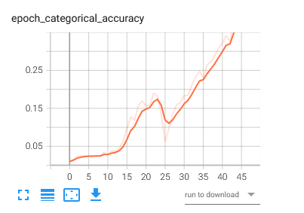
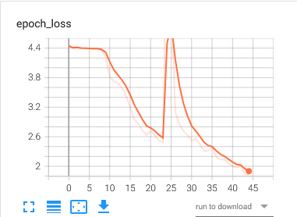
Training
To determine whether our preprocessing of images actually results in a more robust model, we verified on a test set composed of video sequences from the original dataset, and also in real time. In the image below we can see how our model is trained on the dataset collected.

Slide 22
Ethical Issues
-This technology is one that allows a disabled community to further integrate into an abled community, and may be viewed as an assimilation and bending to the rules of a privileged community. This may reduce efforts of hearing people to accommodate for deaf people.
-The dataset needs to be diverse enough to include every key point involved in communication.
-Detection should be resilient and fast in order to be able to be used in professional places or events.

Slide 23
Reflections
Key Learnings
Train Early and Often: Due to the long training time of our model, it became cumbersome to test various hyperparameters, architectures, image filtering, etc. In future projects, training earlier can identify such issues and more time can be dedicated to training.
Amount of Data: Increasing the training set size leads to drastic improvement in model performance. This likely increases the robustness of the model through learning more of the possible sample space.
Future Steps
Collecting Dataset for various other key words used in communication. For the model to detect more accurately we need to collect our data with a plain background and cloth or attire which doesn’t affect the keypoint detection.

Slide 24
References :
https://towardsdatascience.com/7-tips-to-choose-the-best-optimizer-47bb9c1219e
https://towardsdatascience.com/overview-of-various-optimizers-in-neural-networks-17c1be2df6d5
https://www.youtube.com/watch?v=qcdivQfA41Y

Slide 25


